Slide 1

Traffic Sign Recognition
CV Project
Presented by Karim Kayal & Leen Barnieh

Slide 2
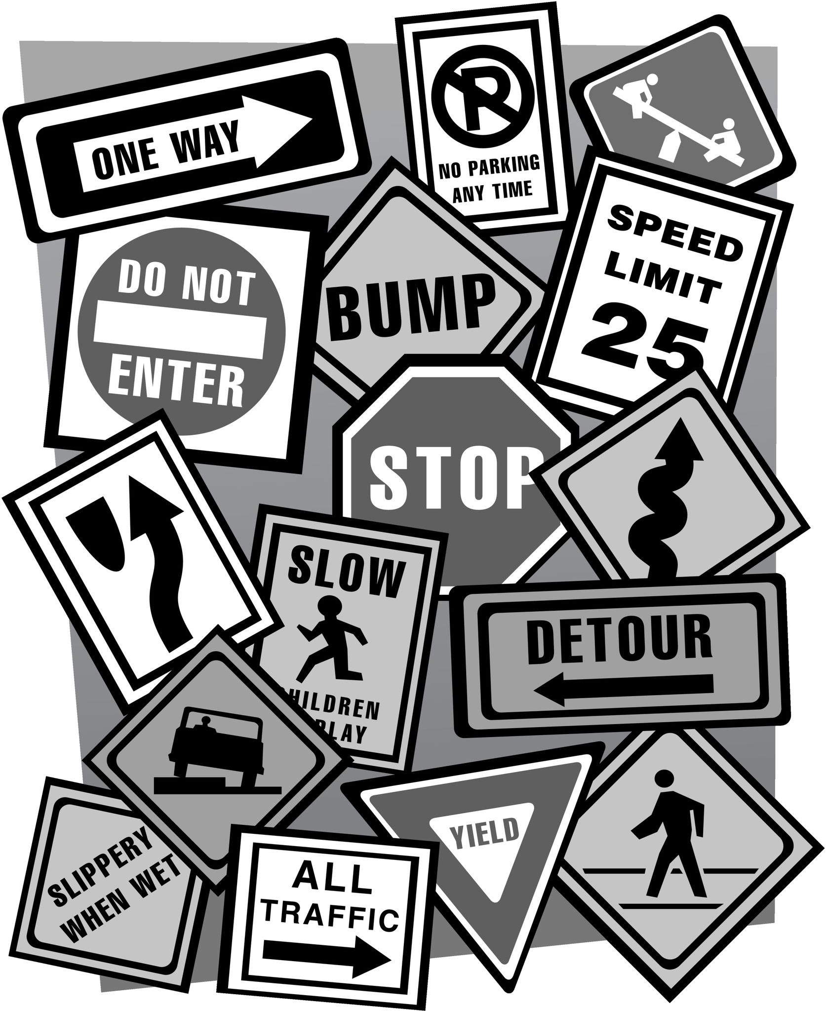
How many traffic signs are there?
What if we didn’t have to interpret them?
Our Idea
Multiple traffic signs are set on the road and not all humans can read them fast, so what if the computer read them for us?

Slide 3



Objectives:
Faster Reading
Can read multiple signs at once
No human interaction needed
Create a computer vision model that is capable of detecting traffic signs in images/videos, read them, and then explain them to the user

Slide 4
This the roadmap that we followed
1
2
3
4
5
Chosen Dataset
The models we worked on
Training the models
Implemented the logic
Deployment and testing
We worked on GTSDB for detection and GTSRB for classification
We fine-tuned Yolov5 for detection and MobileNetV2 for classification
We trained Yolov5 on GTSDB and MobileNetV2 on GTSRB and we achieved acceptable results according to the researches
We built the Python logic that explains the classified signs
We tested the whole model and logic on real life examples

Slide 5
Here is the summary of each phase in detail
The summary of the model
The dataset
The models
The Logic
The GTSDB have ~600 images which are (~400 train & ~100 val)
We applied augmentation and added some samples from GTSRB in order to increase them to (~1900 train & ~100 val)
We used Yolov8 for object detection and MobileNetV2 for classification which achieved 96% accuracy, trained on GTSRB
We implemented a logic the can either take an image and detect the sign then classify it, or have a video running the do the magic.
Company Name
Quarter Month
Year

Slide 6
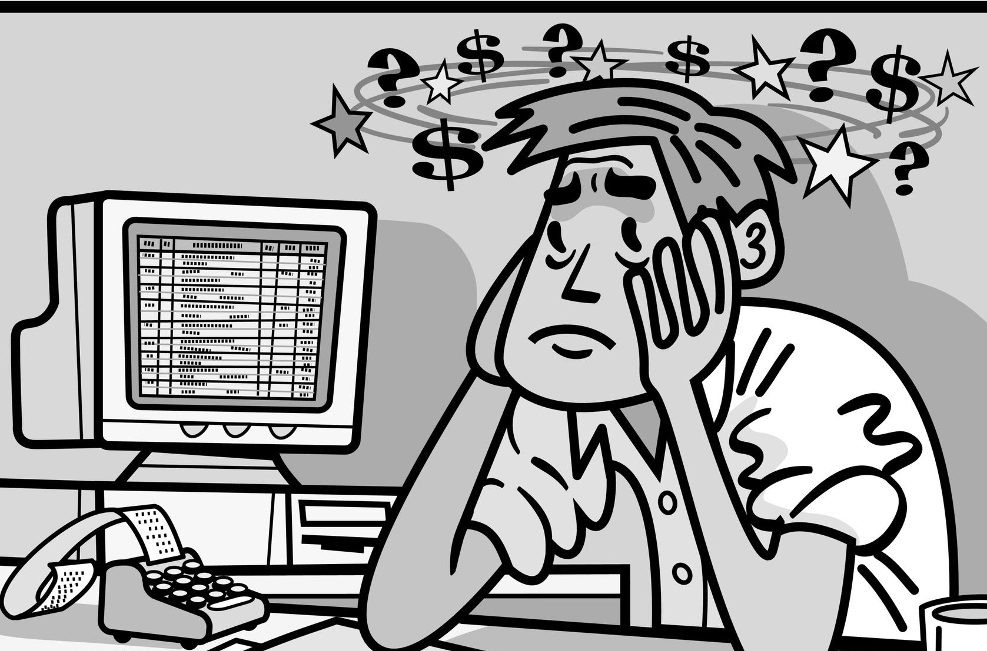
Our Project went through these difficulties
Difficulties we faced
The dataset have high class imbalance
Some signs have very low accuracy
Training took very long, the dataset had to be made smaller to speed up training and we only trained MobileNet
Accuracy is very dependant on FPS and camera quality

Slide 7
We can deliver these objectives in the future to further enhance this project
Fine tune Yolo model (Again, since our work was erased)
Future Works
Implement text-to-speech if possible
Expand on the traffic signs that can be recognized by this model, including the ability to detect language if possible
Implement this project as a full usable system for cars
More Suggestions?

Slide 8
Thank you
Company Name
Quarter Month
Year

